Slide 1
Portfolio website – G Nolan
Aims and priorities
Site outline
Wireframes & basic description
“Mood board” – images, colours, fonts, etc

Slide 2
Aims & Priorities
Showcase skills & technologies
Showcase conformance with industry standards (a11y, responsive, mobile first, validates etc)
Provide central navigation link to projects and own resources
Communicate my character, attitude, and future direction/s
Host any content which aids the above points eg blog posts, reviews of other resources, explanations or mini-lessons on technology-related topics
Provide a means to contact me for professional purposes

Slide 3
Site Outline
Layout ideas:
Logo – tagline - best work - contact info
Good use of whitespace, big background images, illustrations.
Content:
About me – aspiring full stack developer
Early coding
career(RN/aviation/education)
Interests(outdoors/scouting/swim/bfrun/sailing/mbike/dance)
Future Direction
Skills
Projects
A little fun
Euroballs
Other Codecademy???
Useful things
Timerthing.com
Bacon butty
Socundi
Sailor’s Mate
Blog
Useful Resources
Media & CTA

Slide 4

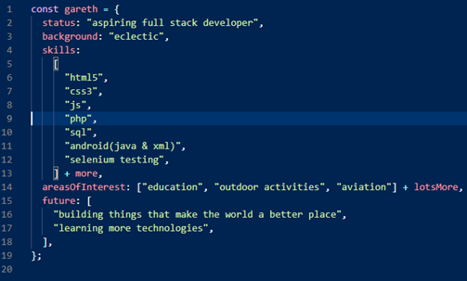
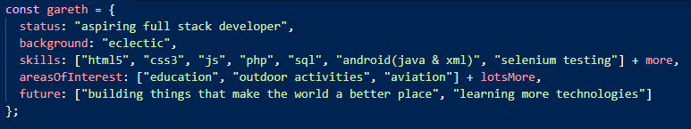

Wireframes & basic description
GNolan
GNolan
About Me Skills Projects Blog Resources Contact
Some photo (dark)
©GNolan 2021
Union Flag BG
©GNolan 2021

Slide 5
Wireframes & basic description
“about me” type area:
GNolan
goto: Item1, Item2, Item3
OR:
2020
Ready
goto:
- Item1
- Item2
- Item3
2010
2000
1990
1980
1978

Slide 6





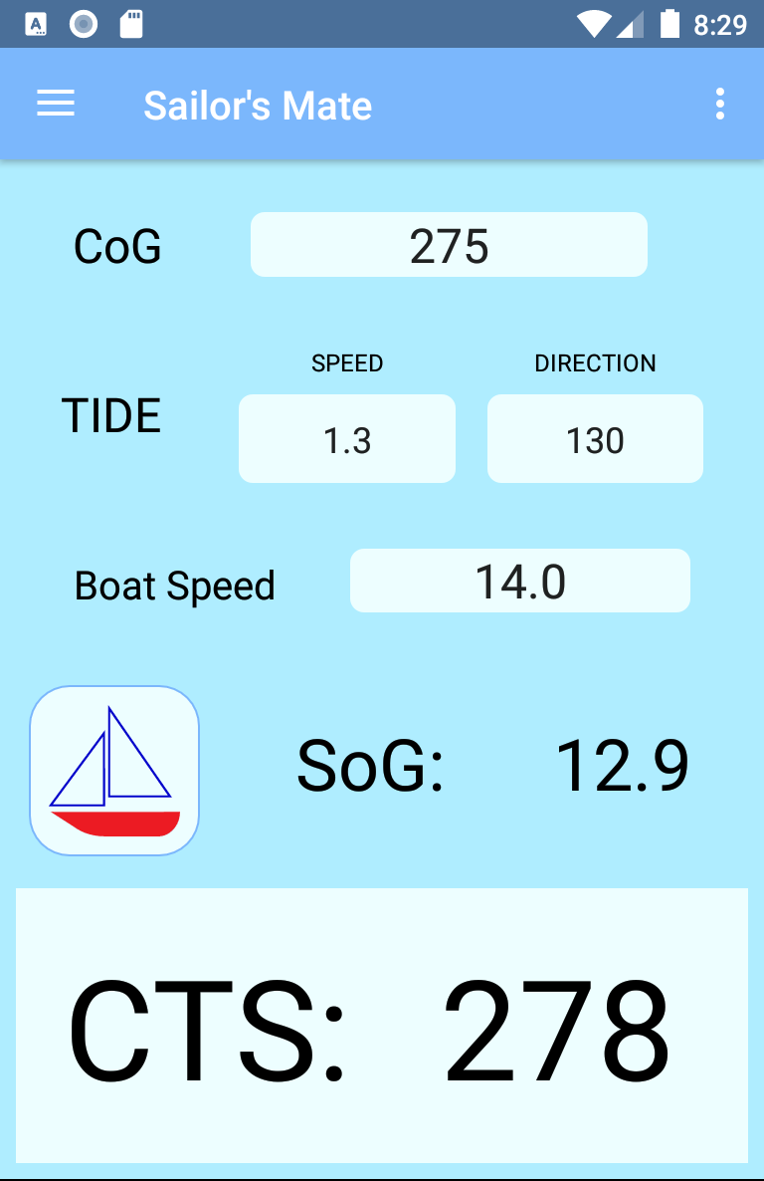
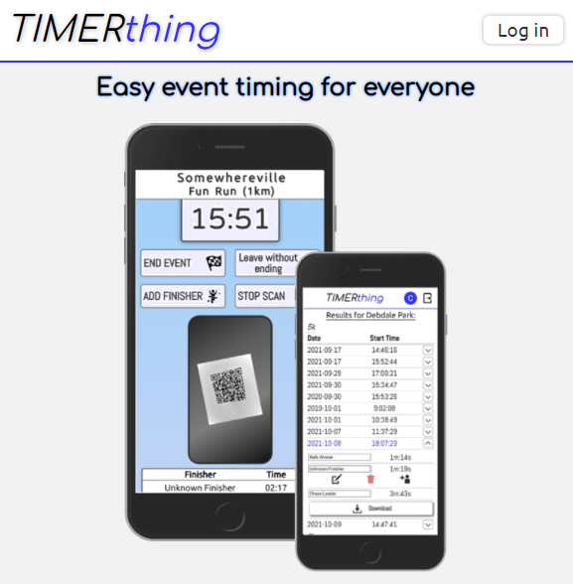

“Projects”
Larger Projects
Timerthing
Sailor’s Mate
Other Projects
Currently Offline
Little Things

Slide 7
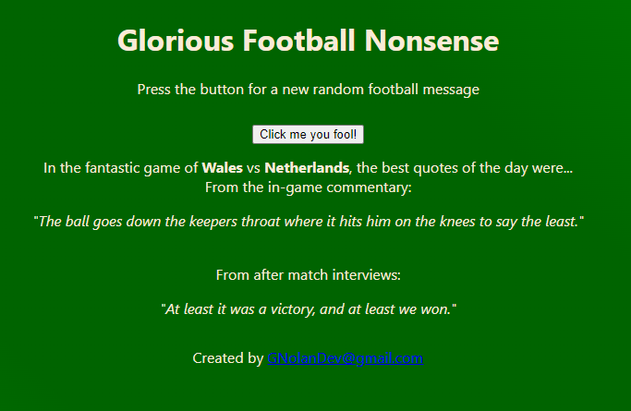
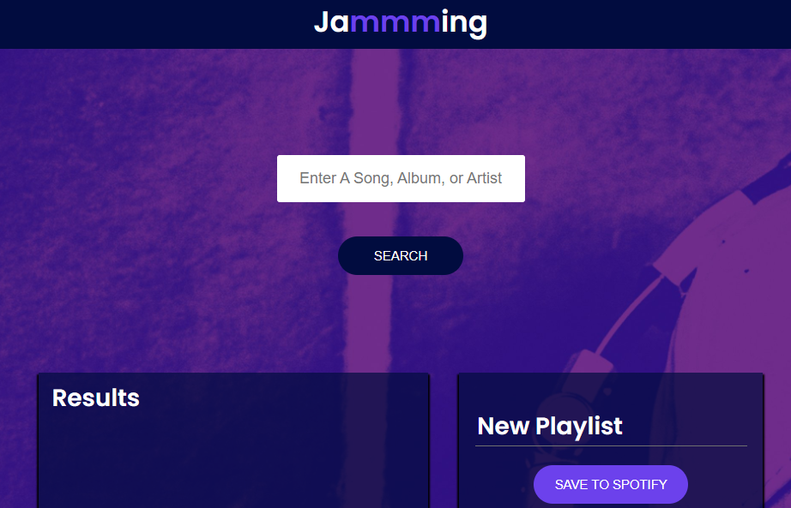
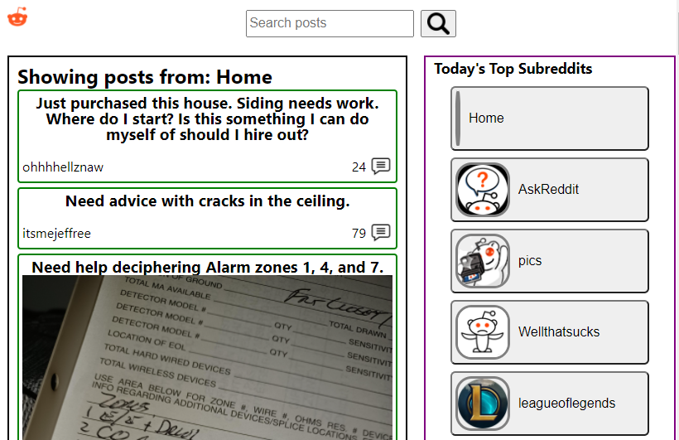
“Projects”
Larger Projects
Other Projects
Euroballs!
Jammming
Reddit
Currently Offline
Little Things

Slide 8
“Projects”
Larger Projects
Other Projects
Currently Offline
Little Things
Euroballs!
Jammming
Reddit

Slide 9
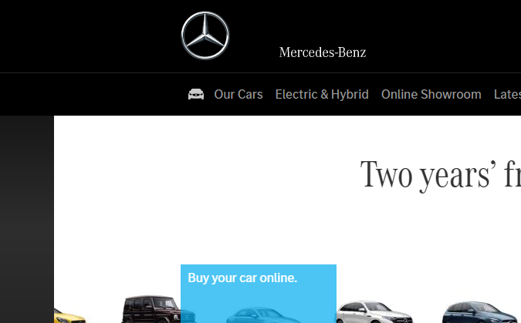

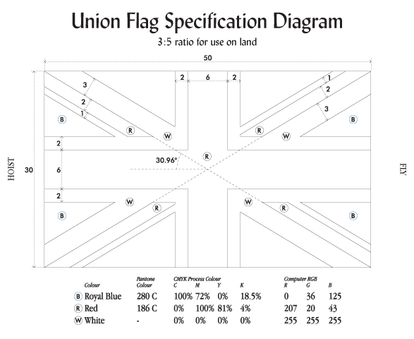


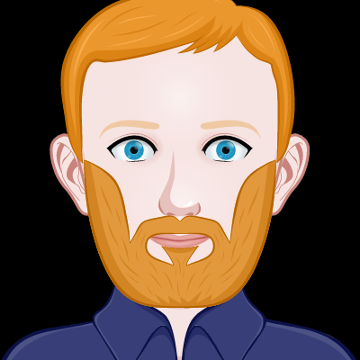


“Mood board” – images, colours, fonts, etc
Union flag:
30:50 ratio
Diagonals 6x(3w/2r/1w)
Red cross 6x
White fimbriation 2x
Blue – rgb(0, 36, 125)
Red – rgb(207, 20, 43)
Some monospace style code-y characters: <> ; {} [] $_ @ ` `
Self as object?!
Use of fragments & links to scroll to sections
Images enlarge slightly on hover
Dark theme, professional, simple, smooth animation on actions (not obtrusive)
Auto-scrolling gallery?
Actions on vert scroll (subtle)

Slide 10
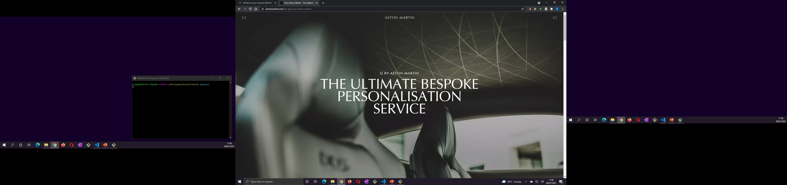
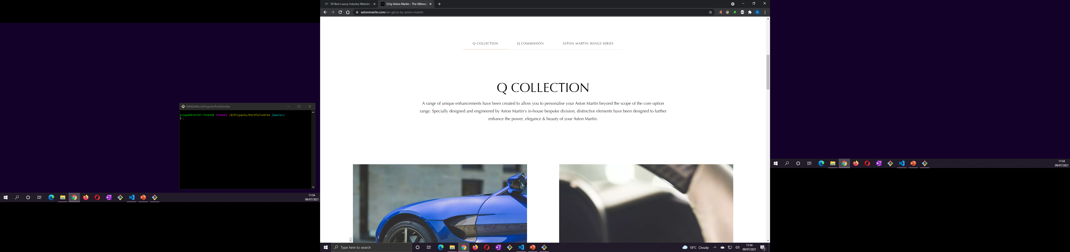
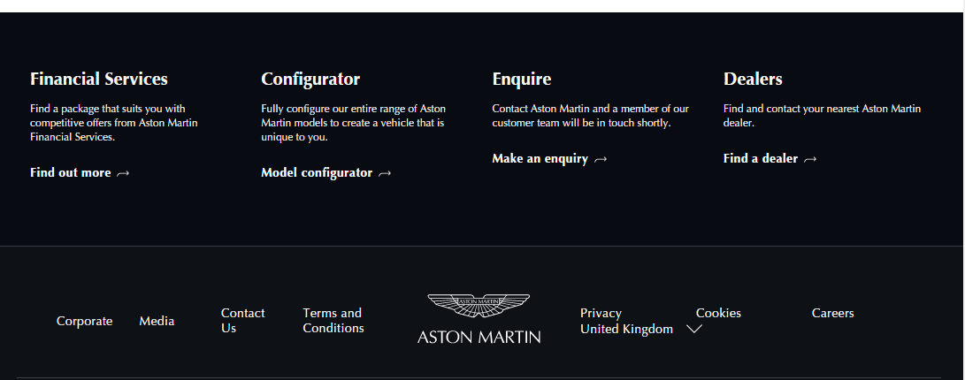
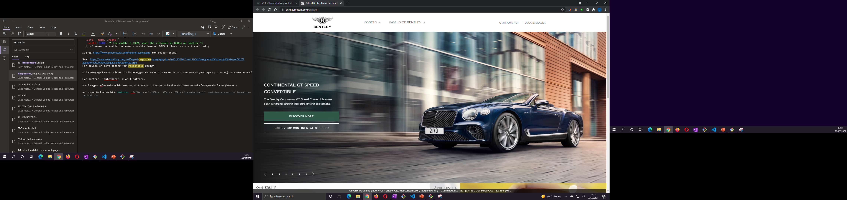
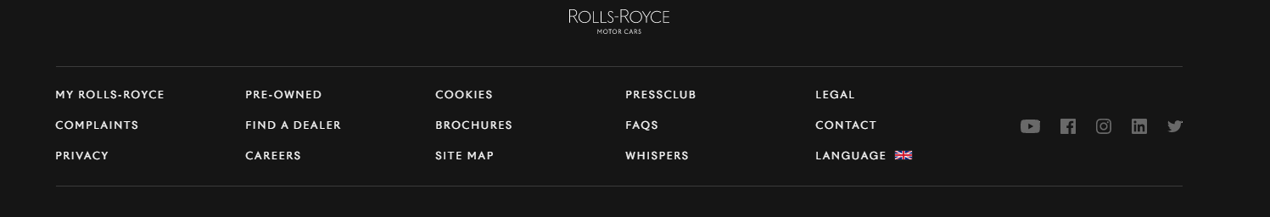
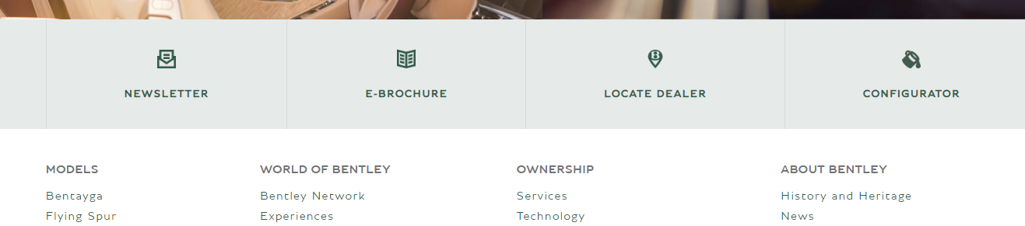
Tabbed navigation with underline changing strength when active – uses ::after (abs pos) for active link with height 1px->3px and change of bgcolour. Used onClick event to manage scroll with js.
Text-transform: uppercase
Optima(paid), Times New Roman, Times, sans-serif;
Nav link – scrolls down
Mouse = small circle, gets larger when hovered over link/button
footer

Slide 11









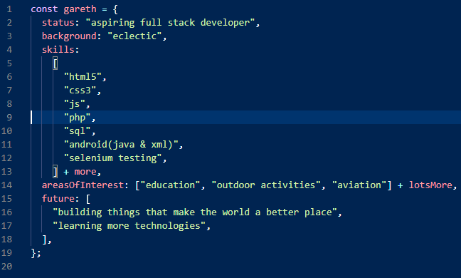
Colours:
Text on dark background: #f9f9f9
Menu underline:
Unfocused: #B3AB93
Focused: #9D9273
Primary #b3ab93
Secondary #78909c
Prim light #e5ddc3
Sec light #a7c0cd
Prim dark #837c65
Sec dark #4b636e

Slide 12
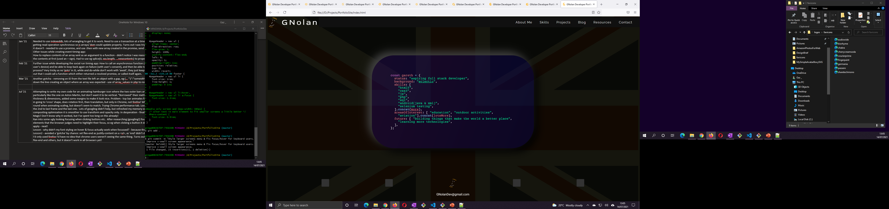
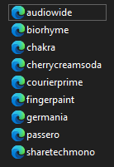
Include obvious references to phone & multiple screen sizes etc.
History of me section – change to sepia / 70s colours as the screen is scrolled?
Favicons?
Made with boxysvg
Must include png also

Slide 13
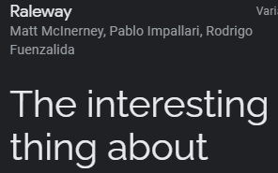
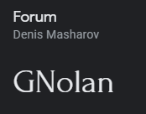
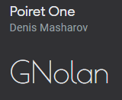
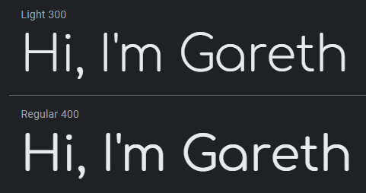
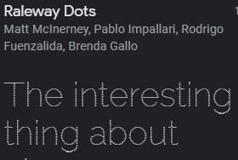
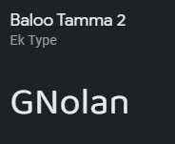
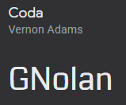

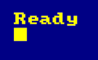
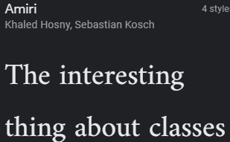
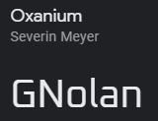

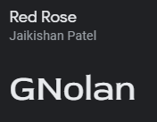
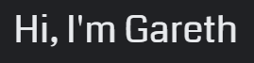
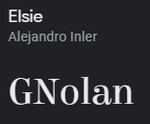
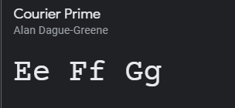
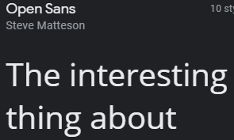

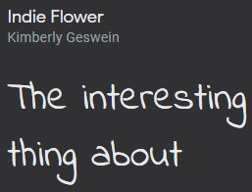
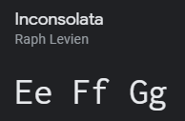
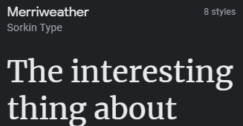
fonts
Comfortaa
Amstrad CPC464
(not from google)
Righteous
Coda
Optima (paid font – nope!)
Courier Prime for code (Consolata is a MS paid font)
Inconsolata (also code option)

